Slide 1



Hispanic Free
Retirement Plans to create
A Lifetime Income

Slide 2

Why a Retirement Plan Matters Today
Planning for retirement isn't just about saving money, it's about securing your future lifestyle and peace of mind.
A retirement plan allows you to take control of your financial future, ensuring that you’re not only prepared for unexpected expenses, but also able to enjoy your retirement years comfortably and on your own terms.
The earlier you start, the more you benefit from compounding growth and tax advantages that can significantly increase your savings over time.
Think of a retirement plan as a personal roadmap to financial independence. It helps you define clear goals, stay disciplined with contributions, and diversify your investments for long-term growth.

Slide 3







Check your Financial Health
Do you currently have a structured retirement plan?
Do you have a guaranteed lifetime income for your golden years when
you retire?
Are you saving any money right now, whether it's a little or a lot?
Do you want to build solid wealth for your family and enjoy a debt-free lifetime income?
Do you want to avoid paying taxes when withdrawing money from
your savings?
Do you have access to low-interest credit without relying on banks?

Slide 4






The Hispanic Free Solution
If you haven’t yet addressed some of these signs of financial health, then contact the specialists at Hispanic Free. They will design a retirement plan tailored to your specific needs, life goals, and financial situation.
Personalized Retirement Plans
Solutions tailored to your unique situation, needs, and goals
Corporate Alliances
Partnerships with major financial corporations
Smart Investment
An optimized financial investment system that enables sustainable growth of your wealth

Slide 5

Personalized Retirement Plans
Hispanic Free, in partnership with major financial corporations and using an optimal investment system, can create retirement plans that traditional methods and corporate finance do not offer.
These retirement plans are the ideal solution for independent workers, micro-entrepreneurs, or anyone not employed by a large company, corporation, or government.
Hispanic Free’s retirement plans will help you achieve the dream of a guaranteed lifetime income, offering you a dignified income and a fulfilling life after retirement.

Slide 6

Corporate Alliances
Hispanic Free’s mission is to solve the retirement planning challenge by offering a wide range of retirement plans and other financial products, made accessible through a unique collaboration system with large U.S. financial institutions.
Major financial companies with decades of experience in the market (some with over 100 years)
Their risk rating is AA+ or higher
They are reinsured and backed by state governments
It is important to note that clients sign the retirement plan (or any other financial contract) directly with the financial institution that guarantees it-without any intermediaries

Slide 7
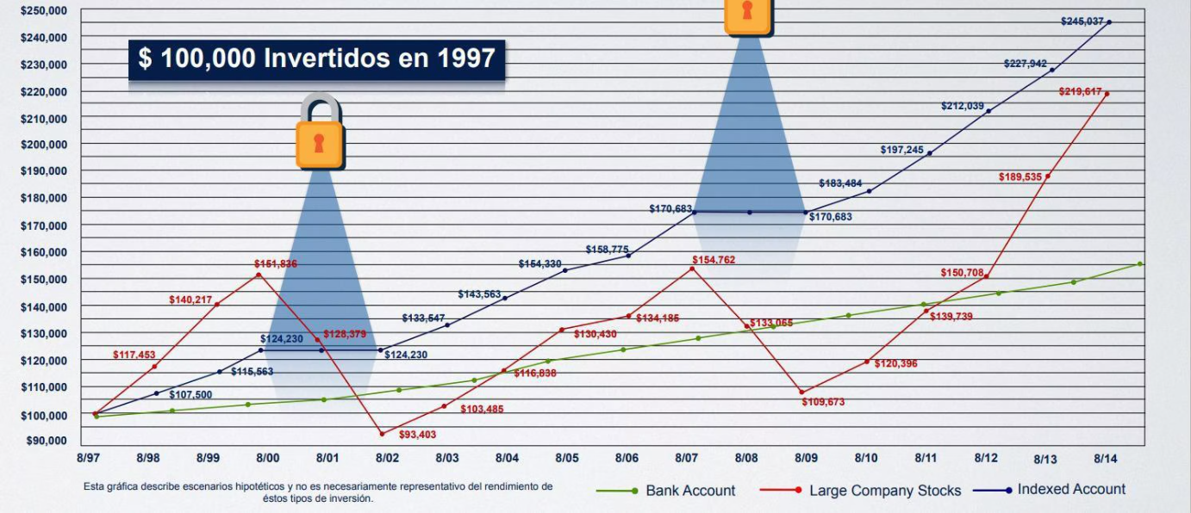
Smart Investment
Most people …
Some people …
Those who know …
Seek security, but their money doesn’t grow - they leave it in the bank, invest in fixed-term deposits, or Treasury bonds
Seek high returns by investing in the stock market, facing high risk and uncertainty
Invest in indexed contracts that balance return with security and offer tax advantages

Slide 8

Main Benefits
Guaranteed Lifetime Income
Flexible Access to Your Money
Family Protection
Secure your financial future and protect your family against unforeseen circumstances by building solid wealth to enjoy during life and leave as a financial legacy
You will receive a lifetime income, debt-free, guaranteed by law thanks to reinsurance and state guarantee funds
Unlike other retirement plans, your access to money is free and permanent. You can withdraw it whenever you want, at any age, with no penalties and tax-free

Slide 9








Exclusive Advantages
Home Protection
Guaranteed Education
A supplement that protects your home, ensuring the mortgage is paid off in the event of any contingency
Supplement your savings to pay for your children's college while building your lifetime income
Infinite Bank
Legal Protection
Access to low-interest financing, without a credit bureau and with immediate approval, leveraged through your retirement plan
Your money is completely exempt from seizure and legal claims in case of lawsuits or legal conflicts

Slide 10





How Hispanic Free Works
Personalized Evaluation
A comprehensive analysis of your current financial situation and future goals
Plan Setup
A retirement plan tailored specifically to your needs
Plan Contracting
The retirement plan is signed with the service provider
Growth and Monitoring
Ongoing monitoring and adjustments to maximize long-term benefits
With Hispanic Free’s retirement plans, by the time you reach retirement—or whenever you choose to end your plan—you will have built a portfolio that allows you to enjoy a lifetime income, offering a dignified income and a full life in your golden years, free of debt and with substantial wealth.

Slide 11

Other Services from Hispanic Free
Hispanic Free, in partnership with Experior, offers a range of complementary financial services for individuals and small to medium-sized businesses:
Life and Health Insurance
Investments
Financial Education
Wealth Planning
Debt Elimination
Strategies to Reduce Tax Payments

Slide 12

Ready to Secure your Future?
100%
0%
Legal Guarantee
Taxes on Withdrawals
All our plans are backed by state guarantees and legal protection
Withdraw your money tax-free whenever you need it
Now it’s up to you to make your dreams a reality!
Let’s take the next step:
Your Financial Analysis

