Slide 1






Slide 2


AGENDA
Who We Are
What We Do
The Experior World
Compensation & Ownership

Slide 3

Who We Are
How we made it here

Slide 4

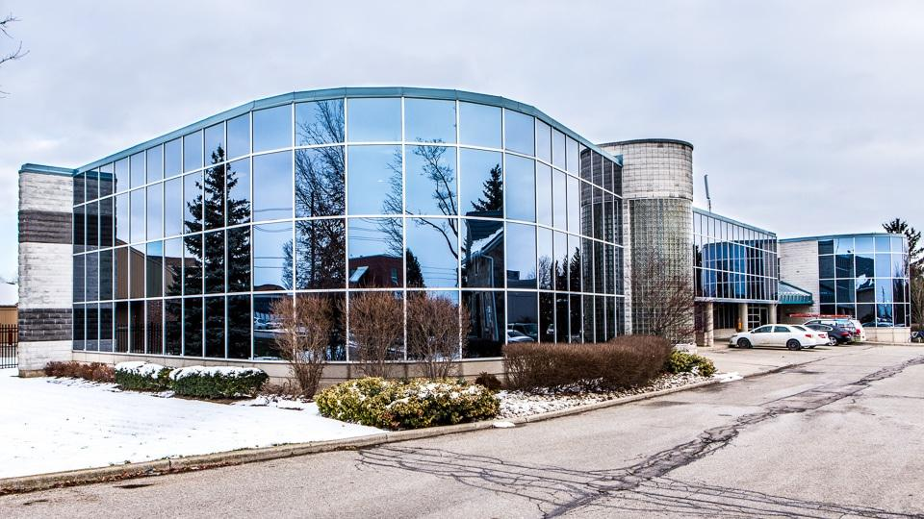

We are an MGA/IMO
Managing General Agency (Canada)
Insurance Marketing Organization (USA)
Founded in Canada in 2014
Over 11,000 licensed agents
First Canadian born Insurance Brokerage to open a head office and expand to USA
Canadian Head Office located in Guelph, Ontario
USA head office located in Buffalo, New York

Slide 5

WE BELIEVE IN THE POWER OF CHOICE
FINAL EXPENSE
TERM LIFE INSURANCE
401(K) - 403(B) – IRA ROLLOVERS
HEALTH INSURANCE PLANS
WHOLE LIFE INSURANCE
ANNUITIES

Slide 6


What We Do

Slide 7



Mission Statement
Building Financial Foundations
for Families to Empower Them Today, and Leave a Legacy for Tomorrow

Slide 8
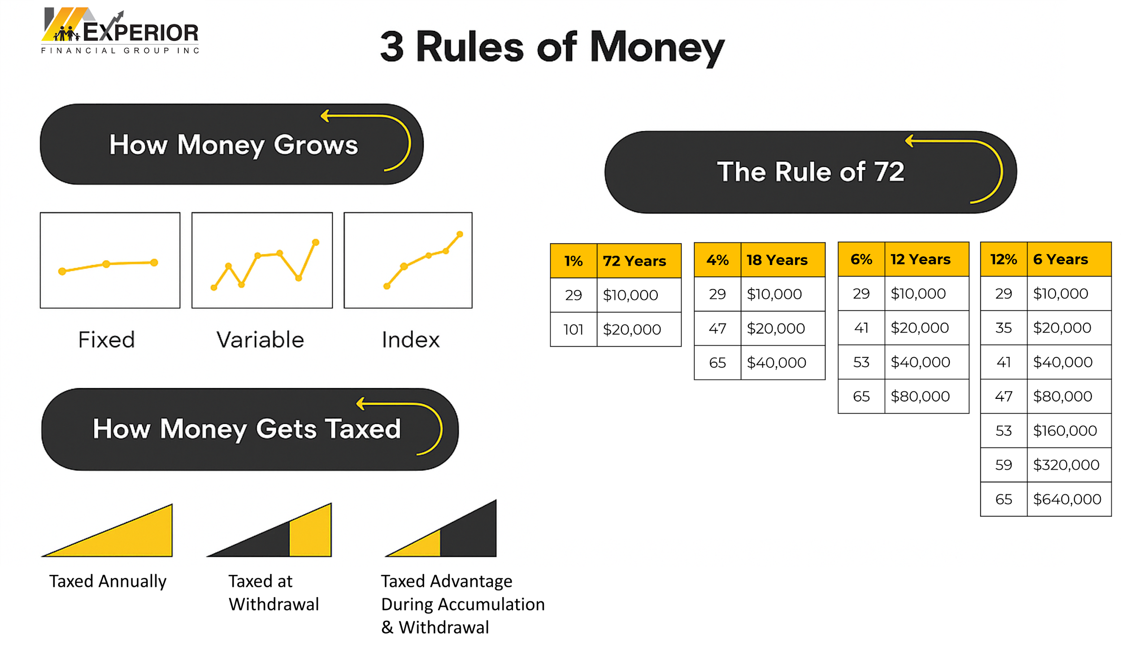



Divide the % into the number 72 to determine how long it takes for your money to double
Albert Einstein is often credited with saying, “ Compound interest is the most powerful force in the universe.“
What it means in simple terms:
When your money earns interest, and then that interest earns more interest, it keeps growing faster and faster. Over time, even small amounts can grow into something big.

Slide 9




Taxed Advantage During Accumulation & Withdrawal:
Your money grows faster because no tax is taken out each year.
You earn money on your gains, not just your original amount.
You only pay tax later, when you take the money out.
You might pay less tax in the future if you earn less in retirement.
More money stays in your account longer, helping it grow bigger.
Index:
Market-Linked Growth with Protection: This means you participate in gains when the market performs well, but you don’t lose principal when the market declines.
Balanced Risk and Reward: Unlike variable investments (which fluctuate), indexed growth provides moderate returns with reduced risk.
Compounding Potential: The upward trajectory in the graph highlights consistent compounding growth over time, a key factor in long-term wealth accumulation. Even if annual returns are capped, the lack of downside risk enhances long-term outcomes.

Slide 10
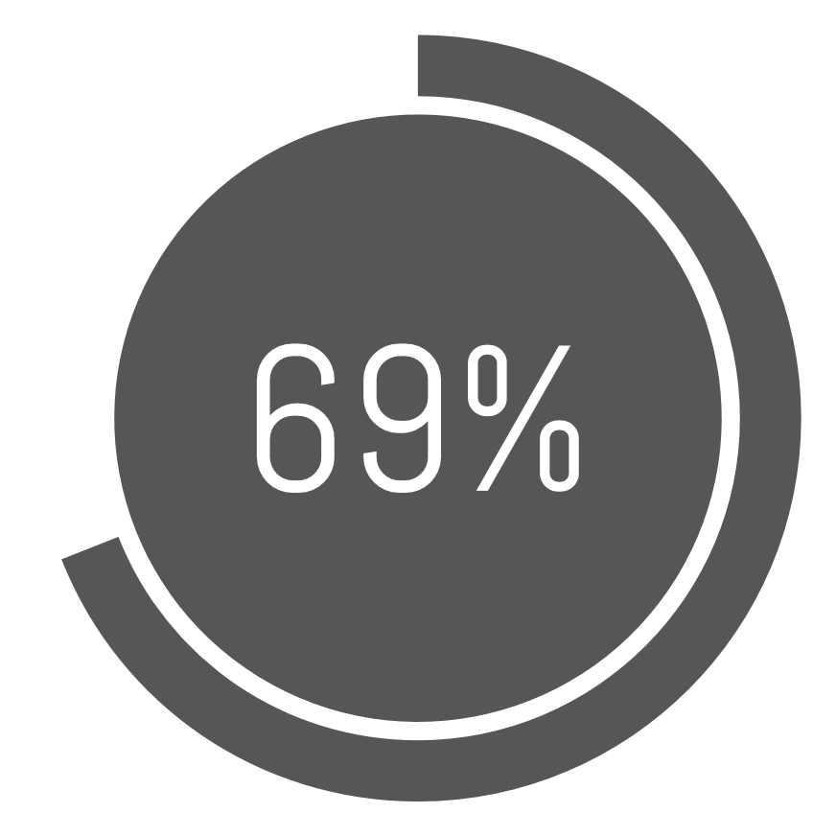

AMERICAN STATISTICS
Some examples of issues that we face as Americans that affect our finances
of adults have less than $1000 in a savings account. Source: GO Banking Rates
Debt
Retirement
Insurance
Investing
The main source of debt for 20% of respondents was credit card debt. Only 18% said their mortgage was their main source of debt.
59% say they will have to keep working longer while 36% believe they will never have enough money to be able to retire.
44% of households would encounter significant financial difficulties within half a year if they lost the primary wage earner in the family. 28% would reach that point in a month.
Key Points Annuity sales hit $310.6 billion in 2022, surpassing the prior annual record set in 2008 by 17%.
Source:
LIMRA: 2022 U.S. Retail Annuity Sales Shatter Annual Sales Records Set in 2008
Source:
Statista Research Dept.2022
Source:
Natixis Global Retirement Index 2021
Source:
Life Insurance Statistics and Industry Trends 2023

Slide 11








THE SOLUTION
Expert Financial Analysis (EFA)
6 Steps To Financial Independence
Proper Protection:
Protect against loss of income
Protect family assets
Debt Management
Consolidate debt
Strive to eliminate debt
Emergency Fund
Save 3-6 months' income
Prepare for unexpected expenses
Preservation of Wealth
Reduce taxation
Living Trust and Wills
Build Wealth
Strive to outpace inflation
Professional money management
Cash Flow
Earn additional income
Manage expenses

Slide 12

The Experior World
Shaking up the Traditional Industry

Slide 13

Why Partner with Us?
For the Customer
For You
An Opportunity to
Change the World
Help impact people’s lives by providing them sound Financial Solutions.
Have fun, build a business and make more money!
Experior wasn’t created for shareholders and investors. It was created to change lives, one person at a time!

Slide 14


CAN I DO IT?
Start Part-time
No Experience Required
Non-stop Trainings
Personal & Business Development
Online Licensing Course
24/7 Video Library
Hands-on Training
MARKETING SKILLS
FINANCIAL KNOWLEDGE
Notes:
One important questions we all ask ourselves at this point is: Can I do this? In other words how does a brand new person GET STARTED and more importantly BECOME SUCCESSFUL in this industry? Now wouldn’t you agree that unless you try something new, you won’t ever know if it is for you or not? So many people go about their lives thinking about making a change or doing something different, but doubt themselves for no reason. Nobody knows how to be an engineer, nurse, accountant, admin staff until they took training, it’s a learned skill. That’s the beauty of our part-time training program. It allows you to keep doing what you are doing, while putting this opportunity to the test! To help you fast track your success, we have office and webinar training weekly that you can plug into, in addition to our Financial concepts training and product knowledge groups. With smart phones today (show your phone) you can be added to our training groups to gain valuable knowledge and information, sometimes within seconds of posting a question. This is VERY POWERFUL! Having top advisors and business leaders helping you along the way is amazing! We believe strongly in personal and business development so that you create a positive mindset for fast-tracking your success. Finally we have discounted courses for getting licensed. (Go to Marketing Financial part) so we all know people who need what we do right? Now if we sent you out today on your own, would you know what to say and how to say it when it comes to money and finance?? Probably not, in fact you may end up saying it wrong and that could deter people from wanting to know more, or refer others to your business. Through our match-up system you get hands-on training with an experienced trainer who works side by side with you to help you share this important information the right way with people you care about. Who do you think will have more success presenting this information? A new person who just started, or an experienced person? Of course the experienced person! You also have to be licensed to discuss financial products with anyone, so that is why we do training appointments with a licensed trainer WHILE you are taking the licensing course. You get the best of both practical and textbook knowledge. This “APPRENTICESHIP PROGRAM” has been successfully utilized for many years in many industries including ours! This is how we have been able to create so many success stories within our company! (Show the $100K wall or talk about recent successes of those in your office…..)

Slide 15



Experior is a “Tri-Brid”
We kept the best and left the rest
Career/Captive Agencies
Strong training
Support programs in place
Brand recognition
IMO/MGA/Broker Dealers
Access to many products
Own your clients
Higher compensation if producing
Networking/Builder Models
Develop multiple agencies
Override structure
National expansion opportunities
Limited product offering
Limited expansion program
Limited exit strategy
Limited agency ownership
No brand recognition, lonely world
Training hit/miss, sink or swim
Brand/Image issues
Heavy compensation goes to top
Training depends on group
Notes:
I will start by explaining the various places you can work in the industry….the strengths and weaknesses of each area. First there is the career, captive agency, this is where you are a career type agent, some examples could be the banks or Sunlife. Generally there is strong training and support and good brand recognition.
If you are highly motivated and a self-starter and already are highly trained, you could work in the MGA/Broker Dealer area, where you have access to many products, you own your clients and have good commission if you are producing.
The third area is the Networking kind of companies out there like Primerica, WFG, and others, where you can develop agencies, have a system to follow and can expand the business.
Now let’s look at the weaknesses, with the Career Captive Agency you are limited in your product offering, this means that you are generally forced to sell that brand, if you work at BMO, you are not going to recommend TD even if it is better for the client, you can’t! Also there is limited expansion for this model and the exit strategy is very limited. With the MGA/Broker Dealer you have limited agency ownership, it’s a lonely world as you are truly on your own and the training is mostly product training as most top advisors don’t necessarily care to share their knowledge. With the Networking model that focuses on recruiting and recruiting, with that comes the brand/image issues, as well most of the compensation goes to the upper echelons meaning you starve until you make it so to speak and training does really depend on the group. So what Experior did was took the best of all 3 models and left the rest and created a Tribrid model to be competitive with the entire industry! With this model we have seen record growth in our numbers year after year! So this is a very exciting company to be part of something so dynamic and powerful for a growing industry!

Slide 16

Compensation
& Promotions

Slide 17






5 Streams of Income
Personal Income
$250/month x 12 = $3,000 x FACTOR (example: 90%) x CONTRACT % = $$$$
Sr. Executive Director + | 120% | = $3,240
Executive Director | 115% | = $3,105
Sr. Manager | 100% | = $2,700
Sr. Financial Associate | 85% | = $2,295
Financial Associate | 70% | = $1,890
Personal Income
Agency Owner
Expansion
Bonuses
Residual

Slide 18



Why Build an Agency
Assuming Average Product Factor of 90%
SFA 85%
SFA 85%
AGENCY OVERRIDE INCOME
$25,000 x 30% Spread x 90% PF = $6,750
ED 115%
PERSONAL INCOME
$25,000 x 115% x 90% PF = $25,875
SFA 85%
SFA 85%
SFA 85%
TOTAL CASH FLOW
$36,250/month = $391,500/year
Annual Premium = $
+ BONUSES
SFA = $5,000 Each

Slide 19
Why Build Agencies
Assuming Average Product Factor of 90%
ED 1st GENERATION INCOME
$250,000 x 14% Spread x 90% PF = $31,500
ED 115%
ED 115%
ED 1st Generation
= 14%
ED AGENCY/PERSONAL INCOME
= $36,250
ED 115%
ED 115%
ED 115%
TOTAL CASH FLOW
$67,750/month = $813,000/year
Annual Premium = $
+ BONUSES
ED = $50,000 Each

Slide 20
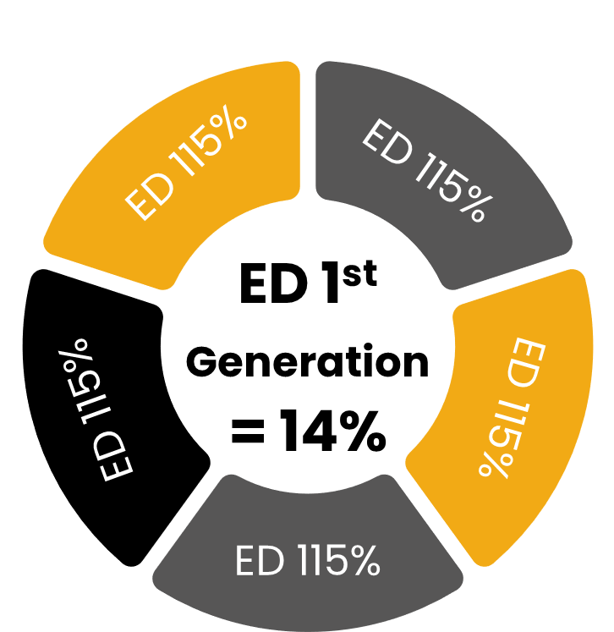

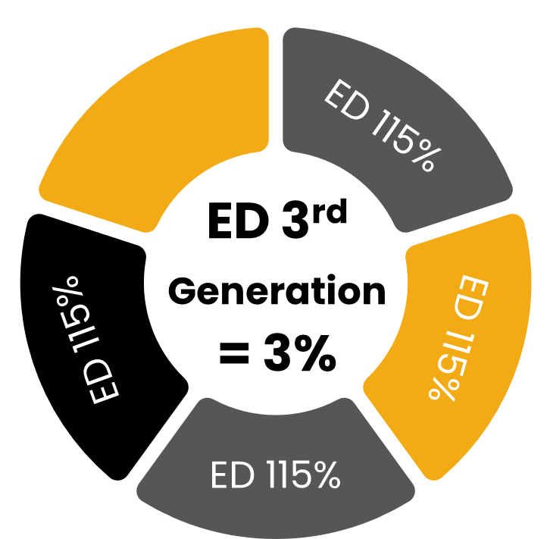
Why Build Agencies
Assuming Average Product Factor of 90%
ED 1st GENERATION INCOME
$250,000 x 14% Spread x 90% PF = $31,500
ED 2nd GENERATION INCOME
$250,000 x 7% Spread x 90% PF = $15,750
ED 115%
ED 115%
ED 3rd GENERATION INCOME
$250,000 x 3% Spread x 90% PF = $6,750
ED 115%
ED AGENCY/PERSONAL INCOME
= $36,250
ED 115%
ED 115%
TOTAL CASH FLOW
$90,250/month = $1.083,000/year
+ BONUSES
+
ED = $50,000 Each
+ BONUSES

Slide 21



OWNERSHIP
Ownership
of Your Clients
Ownership
of Your Agency
Ownership
of Experior

Slide 22

LEGACY OWNERSHIP
We offer every agent the unique opportunity to build an Agency and continue to receive an income upon death, disability or retirement.

Slide 23

AGENT EQUITY OPPORTUNITY
We offer every agent the unique opportunity to become a shareholder in the company and celebrate the company’s financial success.

Slide 24
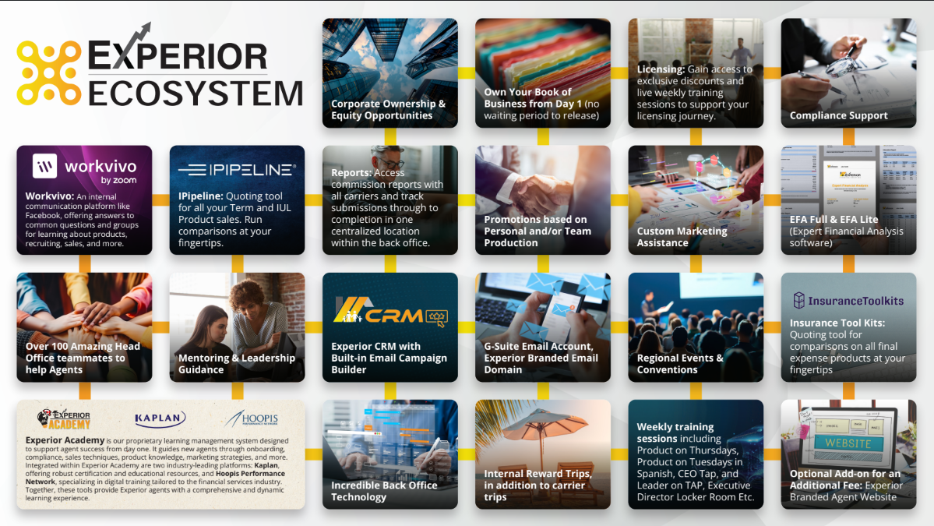

Slide 25
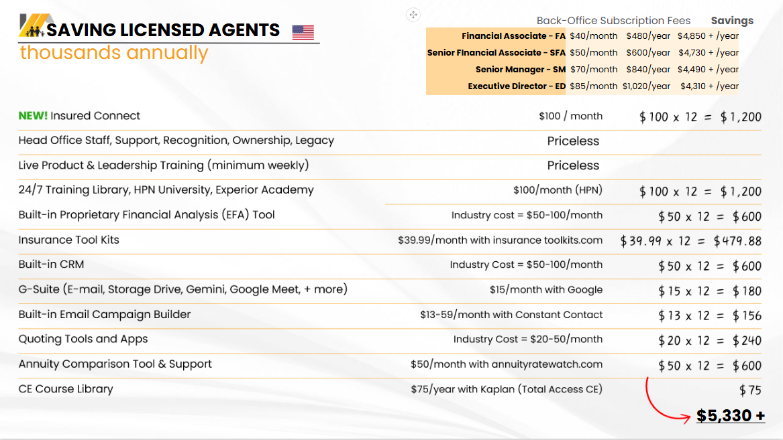

Slide 26
Your Options
Start our part-time training program
Gain an in-depth financial knowledge
Grow a business income to match your goals and dreams
Learn how our concepts and strategies could work in your own situation
BOTH!
Personal
Ultimate
Career

Slide 27


